Slide 1
Vue Js

Slide 2
Getting Started With Vue Js
npm run install –g @vue/cli
vue create project_name
cd project_name
npm run serve

Slide 3
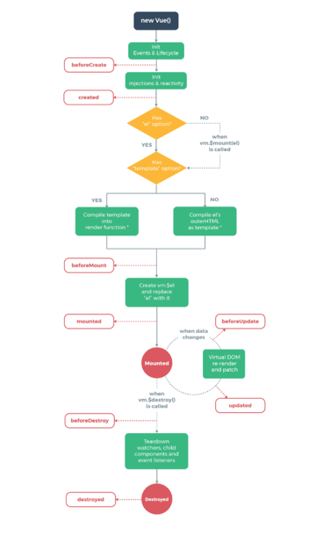
LifeCycle Methods
Methods
beforeCreated
created
beforeMount
mounted
beforeUpdated
Update
beforeDestroyed
destroyed

Slide 4
Uses of Methods
beforeCreated() :- Vue initialize instance’s reactivity and calls the createdHook console.log(‘Before created’, this.list) // Before created undefined
Created() : - Created hook is great time to call ajax call, so it has some time to load before the component is visible to the user. console.log(‘created’, this.list) // Created [array]}
beforeMount() :- Once the virtual DOM is updated vue moves on and updated the real DOM console.log(‘Before mount, this.list) // before mounted [array]}

Slide 5
mounted() :- Here we have access to extra property. This $el property contains the DOM element . We can use it to access the element’s attribute like this.$el.innerText. console.log(‘mounted’, this.list, this.$el) // // mounted [array]}
beforeDestroy() :- whenever you want to turn off event listners like firewall database events this is a best place to do it. console.log(‘mounted’, this.list, this.$el) // // mounted [array]}
destroyed() :- to destroy the instances of the component

Slide 6
Router :-
vue add router this will add router to the application.
If you link the created hook, you can directly execute code as soon as the program starts.
Receive data from child to props
<AddPost v-on:add-post="addPost" />
addPost() {
const newPost = {
title: this.title,
body: this.body
};
//send to parent
this.$emit("add-post", newPost);
(this.title = ""), (this.body = "");
}

